Slide 1
IMDB Movie Analysis
Spreadsheet Hyper Link
https://docs.google.com/spreadsheets/d/1T2RBqMZfvQClR6ZBuMZ9QdHdjcHgBnyh/edit?usp=sharing&ouid=111691645789497796027&rtpof=true&sd=true

Slide 2
Project Description
The project aims to analyze the factors influencing the success of movies on IMDB. Success, in this context, is defined by high IMDB ratings. The dataset contains information on various aspects of movies, including genres, duration, language, directors, and budgets. The goal is to provide actionable insights for movie producers, directors, and investors to make informed decisions in their future projects.

Slide 3
Approach
The project commences with a meticulous data cleaning phase, ensuring data integrity. Following this, an exploratory data analysis investigates the relationships between movie genres, duration, language, director, and budget with IMDB ratings. Leveraging statistical measures and the Five 'Whys' approach, the study aims to uncover key factors influencing movie success. Specific data analytics tasks, such as genre and duration analysis, language examination, director influence assessment, and budget correlation exploration, provide detailed insights. The final report combines these findings into a cohesive narrative, utilizing visualizations to communicate actionable insights for stakeholders in the film industry. Overall, the project offers a targeted approach to understanding the multifaceted dynamics that contribute to a movie's success on IMDB.

Slide 4
Tech-Stack Used
The project leverages Microsoft Excel as the primary tool for data analysis and visualization. Excel's versatile functions and features facilitate data cleaning, computation of summary statistics, and the creation of various visualizations, including pie charts, bar graphs, and histograms. The familiar interface of Excel allows for efficient handling of tasks such as handling missing values, clubbing categories, and outlier detection. Additionally, standard statistical functions within Excel contribute to deriving meaningful insights, making it a powerful and accessible tech-stack for this data analytics project.

Slide 5
Insights
1.Movie Genre:
Certain genres may have higher average IMDB scores.
Producers can target genres with a higher likelihood of success.
2.Movie Duration:
There might be a sweet spot for movie duration that correlates with higher IMDB ratings.
Directors can optimize movie length for better audience reception.
3.Language:
Movies in certain languages may be more positively received.
Consideration of language diversity can be crucial for global success.
4.Director Influence:
Identification of top-performing directors can guide hiring decisions.
Understanding the impact of directors on movie success can shape collaboration strategies.
5.Budget Analysis:
Correlation between budgets and earnings can help in financial planning.
Recognition of movies with high profit margins allows for strategic investment decisions.

Slide 6
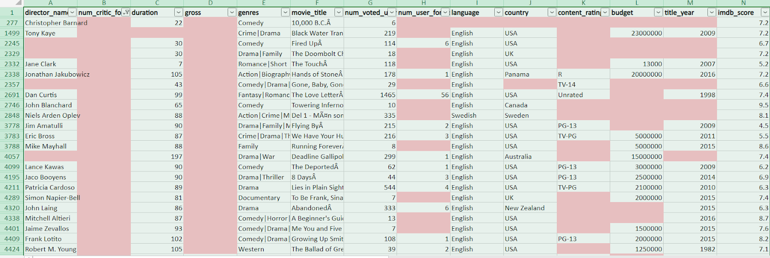
Results
Data Cleaning: This step involves preprocessing the data to make it suitable for analysis. It includes handling missing values, removing duplicates, converting data types if necessary, and possibly feature engineering.
From the provided dataset, I have observed that the dataset contains a lot of empty cells, unnecessary columns. So first I deleted all the columns that do not provide any help for the data extraction.
Next, I found the blank rows and highlighted them, and since there are lot of blank rows I deleted those blank rows.

Slide 7
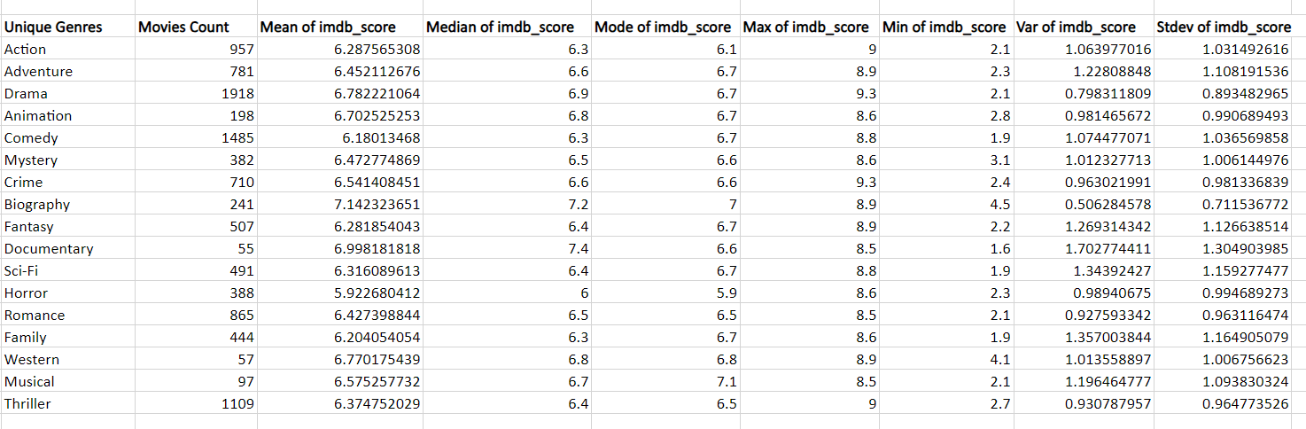
Data Analytics Tasks:
A. Movie Genre Analysis: Analyze the distribution of movie genres and their impact on the IMDB score.
Task: Determine the most common genres of movies in the dataset. Then, for each genre, calculate descriptive statistics (mean, median, mode, range, variance, standard deviation) of the IMDB scores.
Hint: Use Excel's COUNTIF function to count the number of movies for each genre. You might need to manipulate the 'genres' column to separate multiple genres for a single movie. Use Excel's functions like AVERAGE, MEDIAN, MODE, MAX, MIN, VAR, and STDEV to calculate descriptive statistics. Compare the statistics to understand the impact of genre on movie ratings.

Slide 8
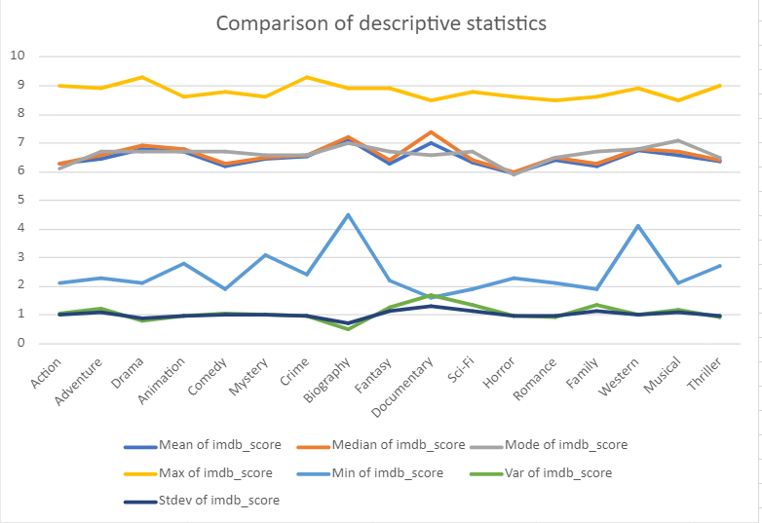

Slide 9
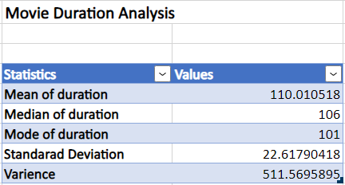
B. Movie Duration Analysis: Analyze the distribution of movie durations and its impact on the IMDB score.
Task: Analyze the distribution of movie durations and identify the relationship between movie duration and IMDB score.
Hint: Calculate descriptive statistics such as mean, median, and standard deviation for movie durations. Use Excel's functions like AVERAGE, MEDIAN, and STDEV. Create a scatter plot to visualize the relationship between movie duration and IMDB score. Add a trendline to assess the direction and strength of the relationship.

Slide 10
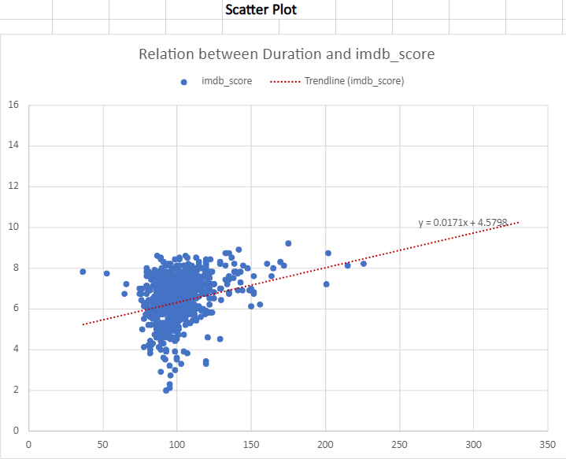

Slide 11
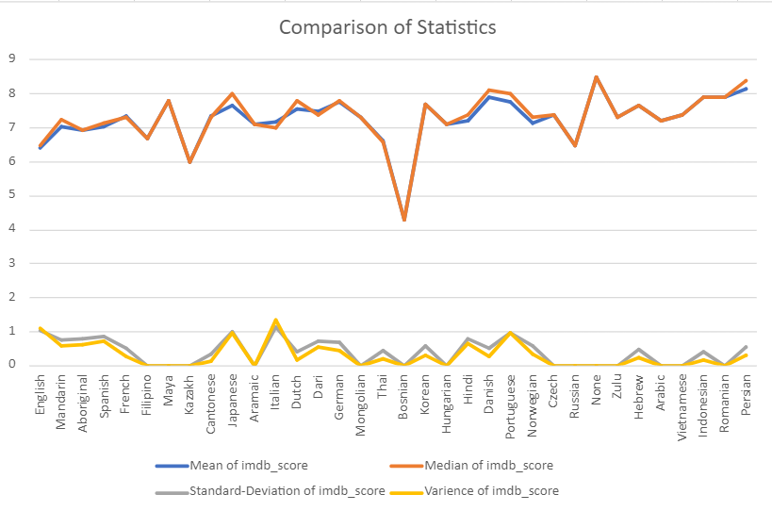
C. Language Analysis: Situation: Examine the distribution of movies based on their language.
Task: Determine the most common languages used in movies and analyze their impact on the IMDB score using descriptive statistics.
Hint: Use Excel's COUNTIF function to count the number of movies for each language. Calculate the mean, median, and standard deviation of the IMDB scores for each language. Compare the statistics to understand the impact of language on movie ratings.

Slide 12
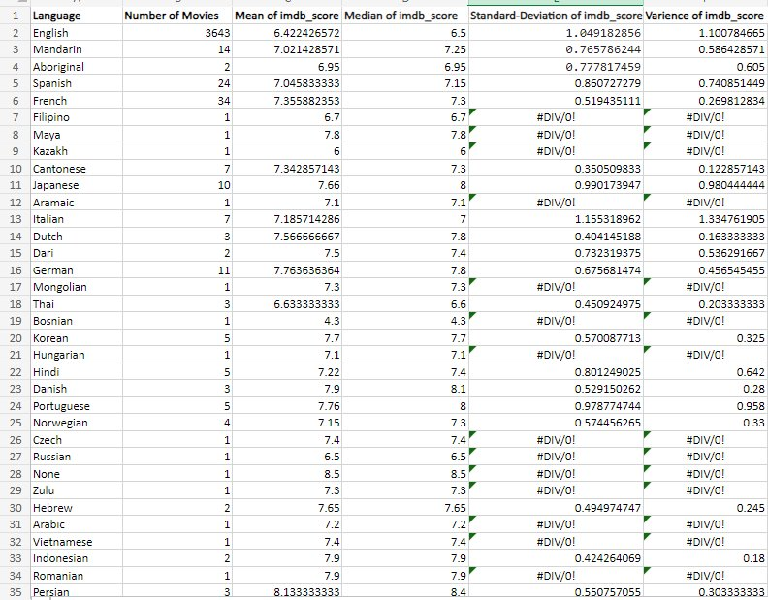

Slide 13
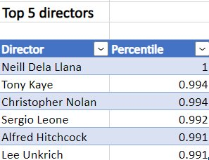
D. Director Analysis: Influence of directors on movie ratings.
Task: Identify the top directors based on their average IMDB score and analyze their contribution to the success of movies using percentile calculations.
Hint: Calculate the average IMDB score for each director. Use Excel's PERCENTILE function to identify the directors with the highest scores. Compare the scores of these directors to the overall distribution of scores.

Slide 14
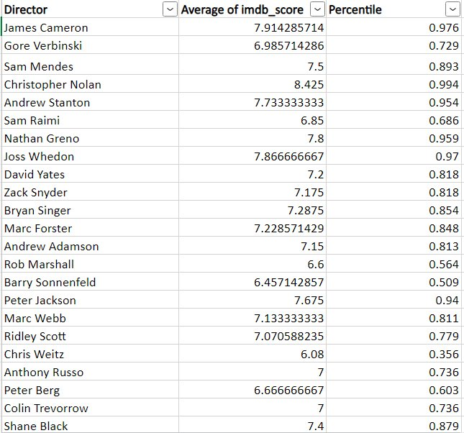

Slide 15
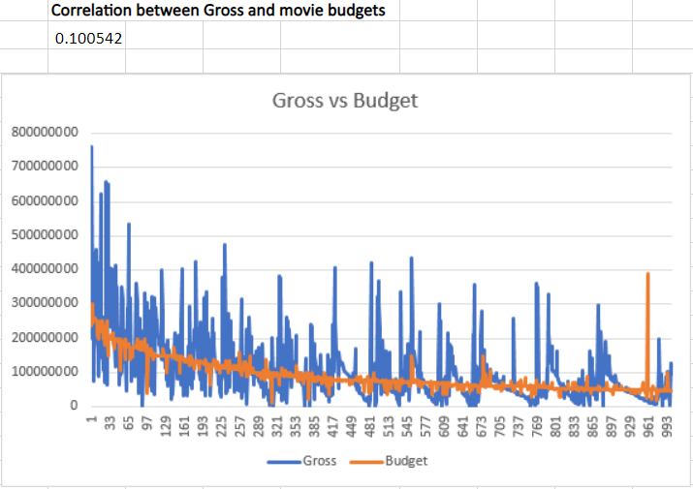
E. Budget Analysis: Explore the relationship between movie budgets and their financial success.
Task: Analyze the correlation between movie budgets and gross earnings, and identify the movies with the highest profit margin.
Hint: Calculate the correlation coefficient between movie budgets and gross earnings using Excel's CORREL function. Calculate the profit margin (gross earnings - budget) for each movie and identify the movies with the highest profit margin using Excel's MAX function.

Slide 16
